Slide 1
The Effect of the Designated Hitter in Major League Baseball
Nick Norton

Slide 2
Outline
Introduce the game of baseball
Sabermetrics and data mining
Designated hitter (DH) and no DH
Average total runs per game of the game
Interleague play comparison
Average total runs per game of the game
Wins by league

Slide 3
History of the DH in MLB
In 1903, the two separate leagues merged to become MLB
By the 1960s, pitchers were dominating hitters
Batting average is the number of hits divided by at bats
1968 batting title awarded to Carl Yastrzemski with a .301
Player to hit over .400 was Ted Williams in 1941
Batting title last year was awarded to DJ LeMahieu with a .348
Popularity had dropped for the once uncontested king of all American sports
Due to poor attendance in the AL, they adopted the DH rule in 1973

Slide 4

AL vs NL rules
Teams in the National League have the pitchers hit
Teams in the American League allow for a designated hitter to replace the pitcher in the batting order
Experiment
Control group (NL)
Experimental group (AL)
Population (MLB)
http://wikamag.com/lifestyle/sports/fall-classic-of-2012/

Slide 5
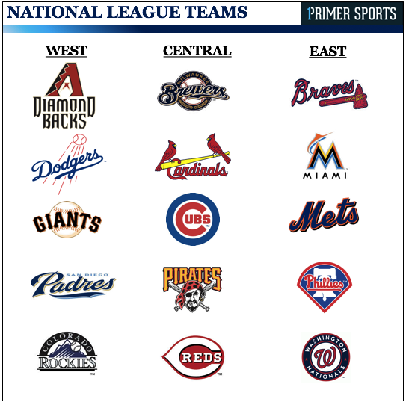
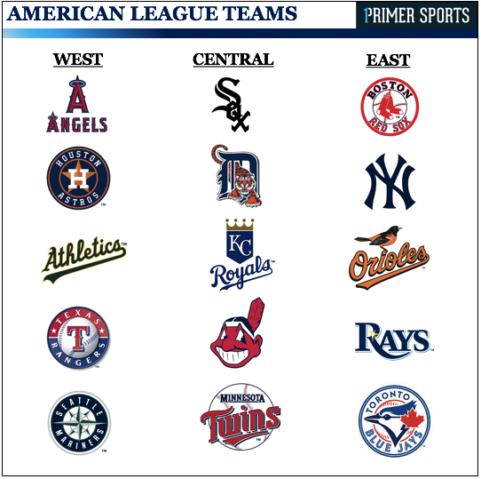
The NL vs the AL
Teams in both leagues play against each other
In interleague play during the season
In the World Series
The home team determines whether or not a DH is used in the game
Only when the AL team is at home is a DH used
When an AL team visits a NL team, the pitcher is responsible for his own offensive production
http://www.primersports.com/
baseball-overview/mlb-overview/

Slide 6
Research
Retrosheet and Lahmen database
Provides statistics of baseball tracing back to 1879
Not all statistics that are tracked were available back then
CS since 1951 and IBB since 1955
97,294 games since the start of the 1973 season
Performed in R which is optimal for statisticians and data miners

Slide 7
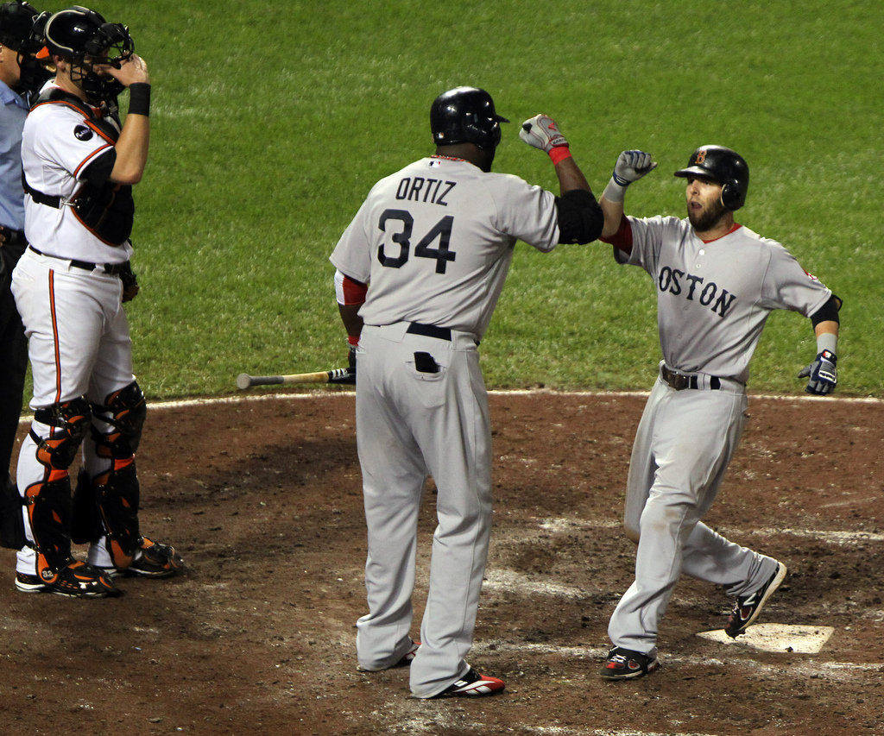
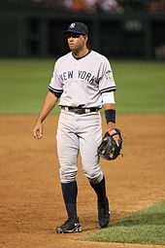
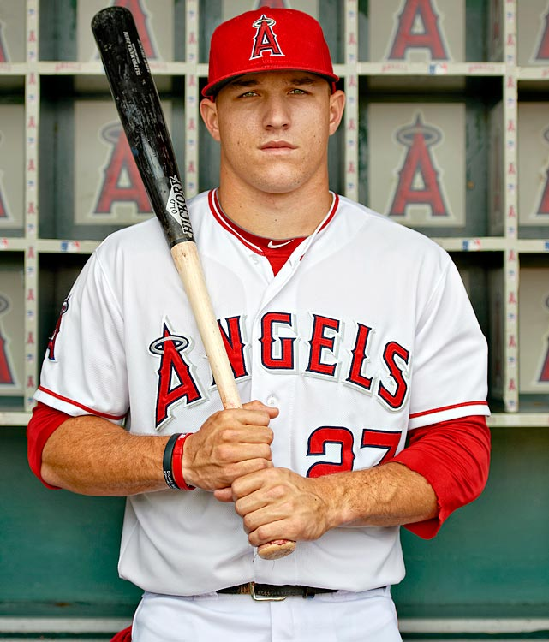
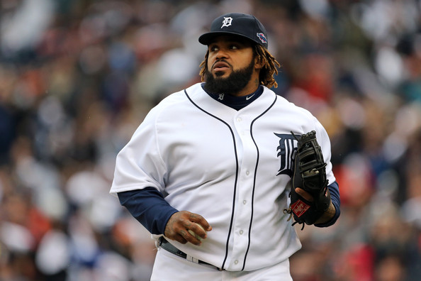
Breaking Biases
http://www.zimbio.com/pictures/Q5UzGPynx65/
Boston+Red+Sox+v+Baltimore+Orioles/XJxkXYWfRm9/Dustin+Pedroia
http://esq.h-cdn.co/assets/cm/15/07/
54d8f1cb65636_-_esq-mike-trout-1212-de.jpg
https://en.wikipedia.org/wiki/Alex_Rodriguez
http://www.zimbio.com/photos/Prince+Fielder/
Division+Series+Oakland+Athletics+v+Detroit/5gMCVsL_Trr

Slide 8

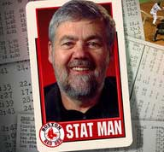
Sabermetrics
Society for American Baseball Research
Established in 1971
“Number crunching” research
Coined by Bill James
Baseball writer, historian, and statistician
“the search for objective
knowledge about baseball”
- Bill James
http://thevideoanalyst.com/bill-james-sabermetrics/
https://www.amazon.com/Moneyball-Art-Winning-Unfair-Game/dp/0393324818

Slide 9

Batting Averages
2016 MLB season
Batting average: $BA=\frac{number of hits}{at bats}$
MLB Positions | Overall BA
NL pitchers | .138
AL pitchers | .106
All pitchers | .135
All players | .254
DH | .260

Slide 10
Pitcher vs Designated Hitter
Why are pitchers such bad hitters?
25 players on the active roster
30 teams in MLB, thus 750 players start the season on the active roster
Usually 12-13 roster spots for pitchers
About half the league consists of pitchers
Rare to find players that can hit and field at the MLB level, only 375 of the best players in the world
Rare to find players that pitch at the MLB league level, only 375 of the best players in the world
Combining these two exceptional skill sets into one player amplifies the scarcity

Slide 11
Baseball Athletes in the USA
455,300 High School
25,700 NCAA
750 MLB
1215 players drafted each year

Slide 12
To DH, or not to DH
In order to add excitement you need to add more offense
Allows aging players losing their defensive fielding to continue to play
Traditionalists argue that the pitcher like any other position should have to hit
Different offensive strategy in the NL than the AL
At the top of the 9th inning and you’re losing, you pull the pitcher to put in a better hitter because if you don’t score then the game is over
Once you take a player out they have to sit out for the rest of the game
In the middle innings, if you don’t think the pitcher can make it through the rest of the game then you pull the pitcher for a better hitter

Slide 13
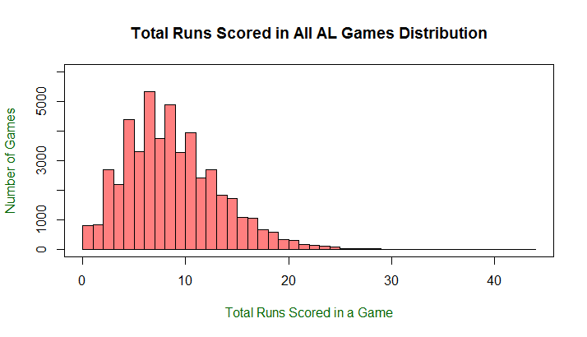
DH vs No DH: AL Games
9.24 average total runs per game

Slide 14
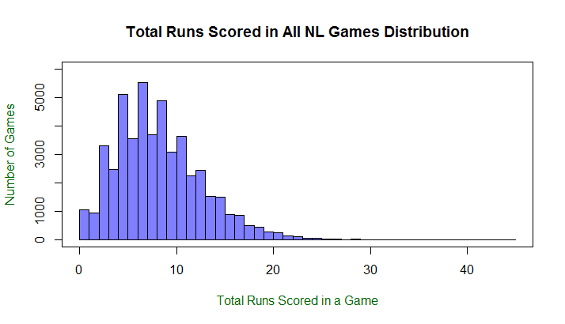
DH vs No DH: NL Games
8.69 average total runs per game

Slide 15
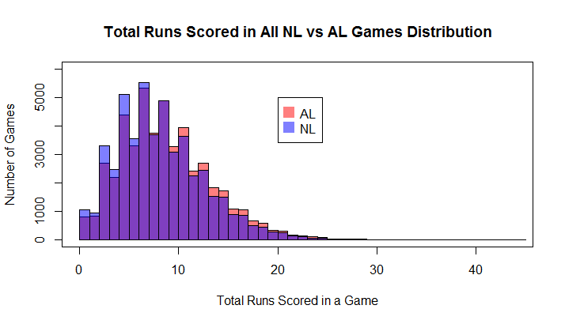
DH vs No DH: Comparison

Slide 16
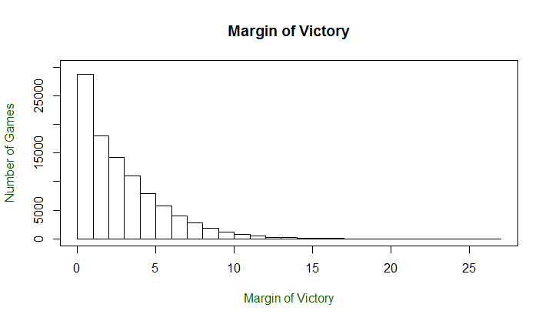
DH vs No DH: Score Differential

Slide 17
DH vs No DH: Comparison

Slide 18
Data
Add up the total runs scored by both teams in all games since 1973
Calculate the mean total runs scored in a game for each season
Address each season as an independent sample
Determine whether a DH was used in the game
Control group: NL (No DH)
Experimental group: AL (DH)
We do not know the true population mean (average total runs per game in a season)
Each mean per season will be a sample mean

Slide 19
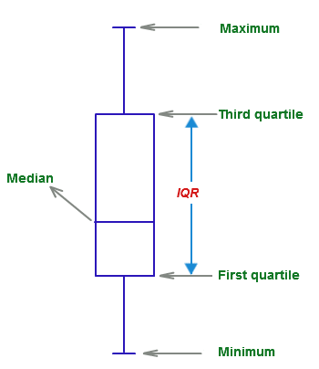
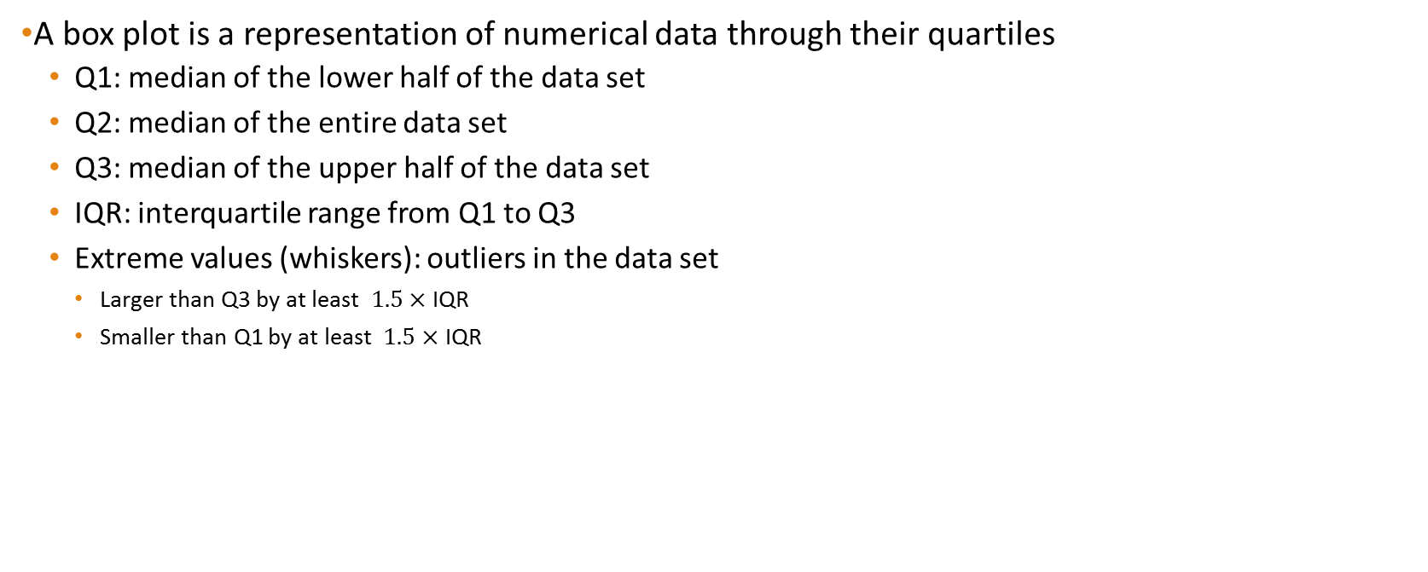
Box plot
A box plot is a representation of numerical data through their quartiles
Q1: median of the lower half of the data set
Q2: median of the entire data set
Q3: median of the upper half of the data set
IQR: interquartile range from Q1 to Q3
Extreme values (whiskers): outliers in the data set
Larger than Q3 by at least $1.5×$ IQR
Smaller than Q1 by at least $1.5×$ IQR

Slide 20
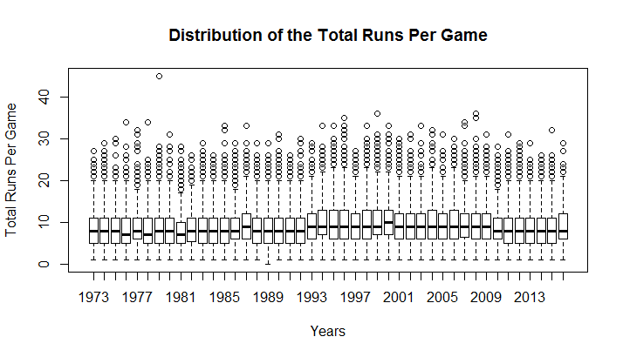
DH vs No DH: Boxplot

Slide 21
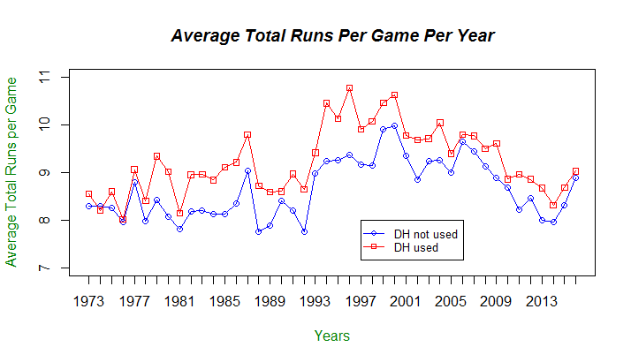
DH vs No DH: Average Total Runs

Slide 22
Confidence Interval
Definition: A range of values that we think has a given probability of containing our mean
We can use the mean and standard deviation from a sample population to construct an interval estimate of potential values for the population parameter
We want to determine how good the estimate is from a given sample mean
Confidence level of an interval estimate is the probability that the interval estimate will contain the population mean
We don’t know the true distribution of runs per game we only have samples of the runs per game from the data we’ve seen.

Slide 23
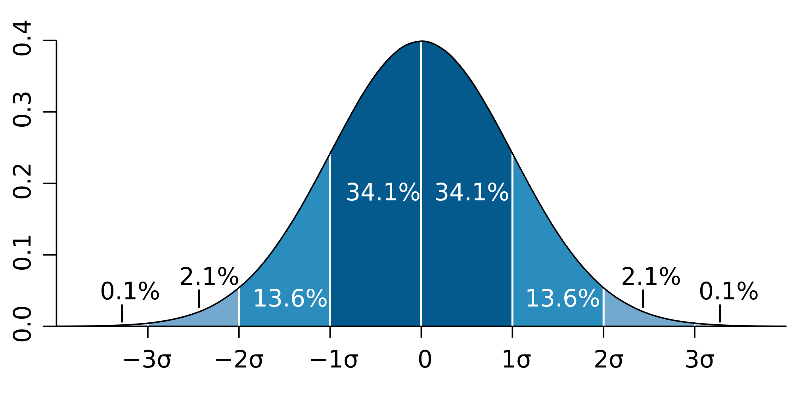
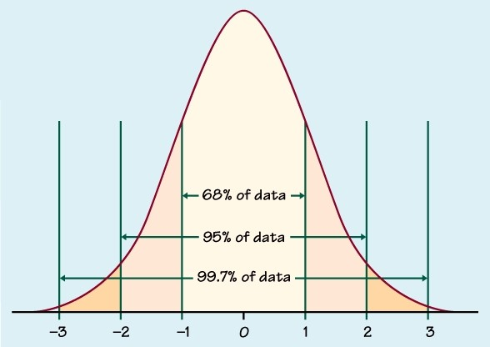
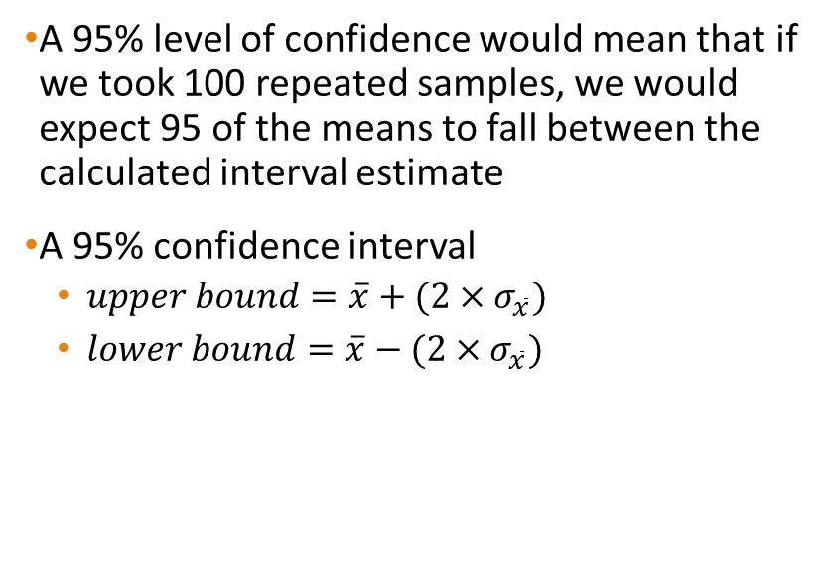
Confidence Interval
A 95% level of confidence would mean that if we took 100 repeated samples, we would expect 95 of the means to fall between the calculated interval estimate
A 95% confidence interval
$upper bound=\overline{x}+(2×σ_{\overline{x}})$
$lower bound=\overline{x}−(2×σ_{\overline{x}})$
https://en.wikipedia.org/wiki/Standard_deviation
https://www.quora.com/Why-is-a-99-confidence-level-wider-when-constructing-confidence-intervals

Slide 24
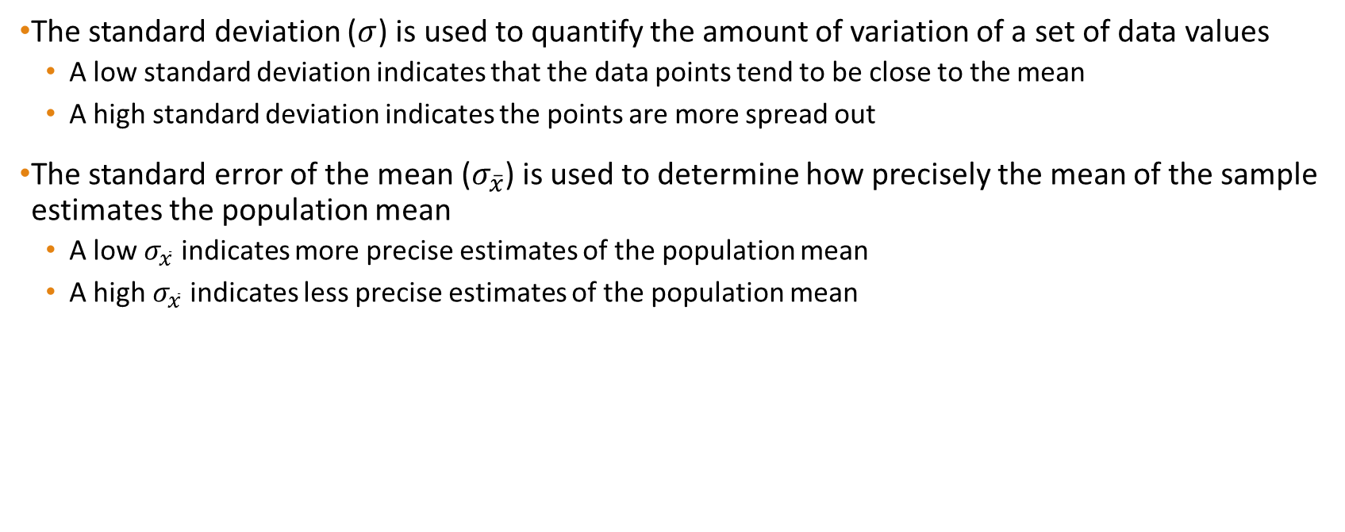
Definitions
The standard deviation ($σ$) is used to quantify the amount of variation of a set of data values
A low standard deviation indicates that the data points tend to be close to the mean
A high standard deviation indicates the points are more spread out
The standard error of the mean ($σ_{\overline{x}}$) is used to determine how precisely the mean of the sample estimates the population mean
A low $σ_{\overline{x}}$ indicates more precise estimates of the population mean
A high $σ_{\overline{x}}$ indicates less precise estimates of the population mean

Slide 25

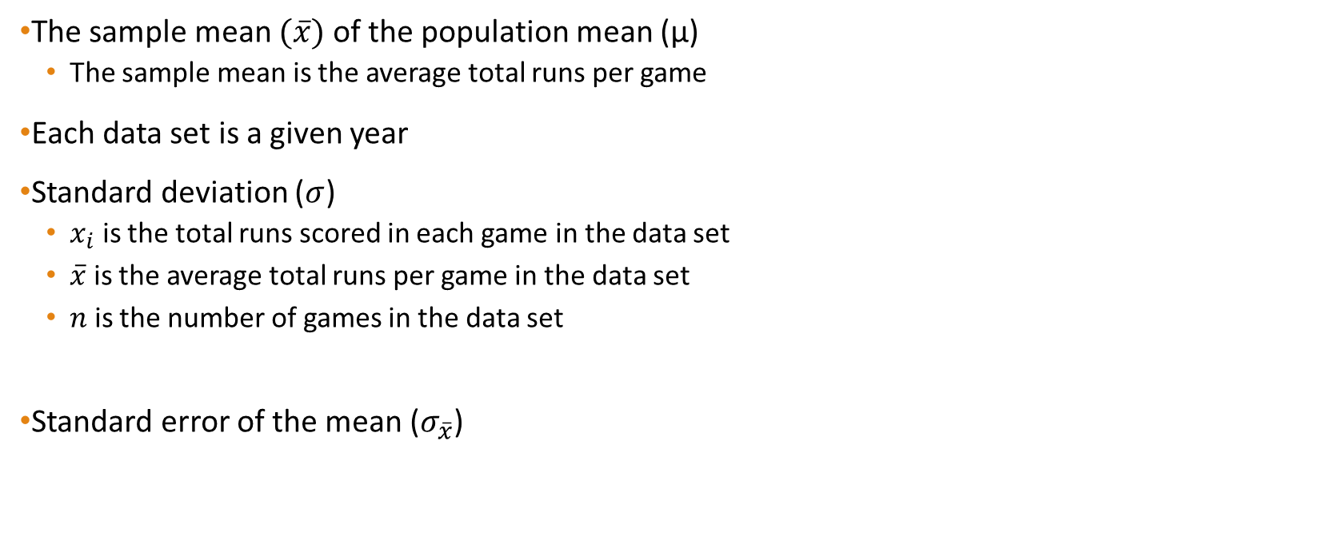

Confidence Interval
The sample mean $(\overline{x})$ of the population mean (μ)
The sample mean is the average total runs per game
Each data set is a given year
Standard deviation ($σ$)
$x_{i}$ is the total runs scored in each game in the data set
$\overline{x}$ is the average total runs per game in the data set
$n$ is the number of games in the data set
Standard error of the mean ($σ_{\overline{x}}$)
$$σ =\sqrt{\frac{\sum{(x_{i}−\overline{x})^{2}}}{n −1}}$$
$$σ_{\overline{x}}= \frac{σ}{\sqrt{n}}$$

Slide 26
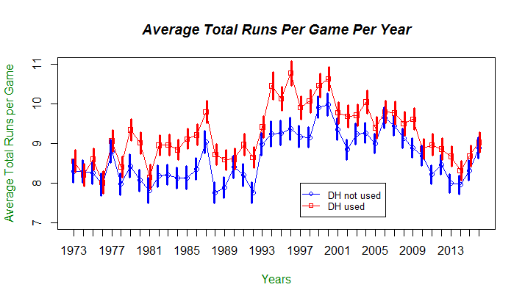
DH vs No DH: Confidence Interval

Slide 27
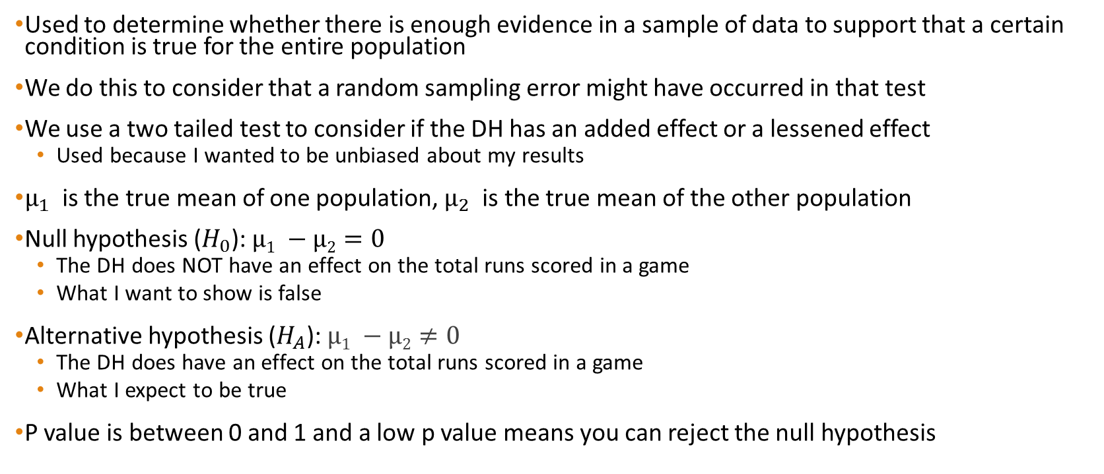
ANOVA: P Values
Used to determine whether there is enough evidence in a sample of data to support that a certain condition is true for the entire population
We do this to consider that a random sampling error might have occurred in that test
We use a two tailed test to consider if the DH has an added effect or a lessened effect
Used because I wanted to be unbiased about my results
$μ_{1}$ is the true mean of one population, $μ_{2}$ is the true mean of the other population
Null hypothesis ($H_{0}$): $µ1 −µ2=0$
The DH does NOT have an effect on the total runs scored in a game
What I want to show is false
Alternative hypothesis ($H_{A}$): $µ1 −µ2≠0$
The DH does have an effect on the total runs scored in a game
What I expect to be true
P value is between 0 and 1 and a low p value means you can reject the null hypothesis

Slide 28
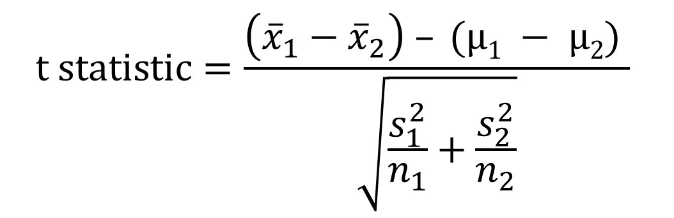

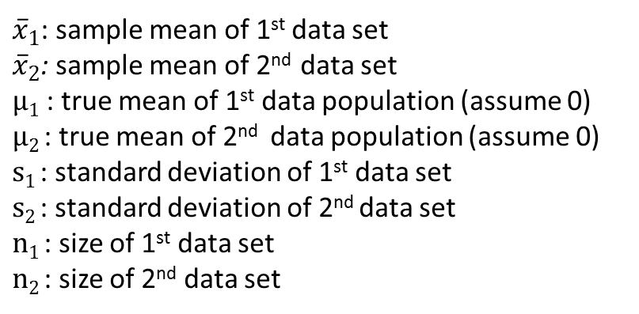
P Values
A significance level of <0.05 indicates strong evidence that we reject the null hypothesis
A significance level of >0.05 indicates weak evidence that we reject the null hypothesis
We use our $t$ value and the degrees of freedom ($n−1$) to determine the p value
${\overline{x}}_{1}­$: sample mean of 1st data set
${\overline{x}}_{2}$: sample mean of 2nd data set
$µ1$: true mean of 1st data population (assume 0)
$µ2$: true mean of 2nd data population (assume 0)
$s1$: standard deviation of 1st data set
$s2$: standard deviation of 2nd data set
$n1$: size of 1st data set
$n2$: size of 2nd data set
$$t statistic=\frac{\left({\overline{x}}_{1}­−{\overline{x}}_{2}\right) – (µ1 − µ2) }{\sqrt{\frac{s_{1}^{2}}{n_{1}}+\frac{s_{2}^{2}}{n_{2}}}}$$

Slide 29
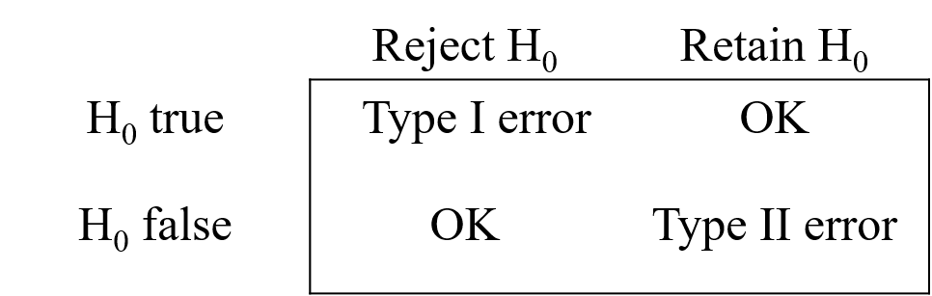
P Values
Two possible errors:
Type 1 Error: We could reject our null hypothesis but in fact it was actually true
I tell everyone that the DH does effect the average total runs per game even though it doesn’t
Type 2 Error: We could fail to reject our null hypothesis but in fact it was actually untrue
I tell everyone that the DH does NOT effect the average total runs per game even though it actually does
A significance level of 0.05 indicates a 5% risk of concluding that a difference exists when there actually is no difference

Slide 30
Confidence Intervals vs P Values
P values only focus on whether or not there is evidence to support a significant effect
Confidence intervals tell us about the range of values of an estimated effect
Provides more information about how big or small the true effect might possibly be

Slide 31
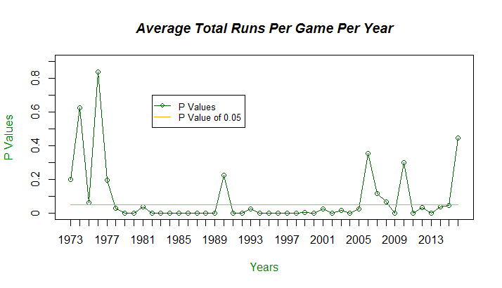
DH vs No DH: P Values

Slide 32
DH vs No DH: Confidence Interval

Slide 33
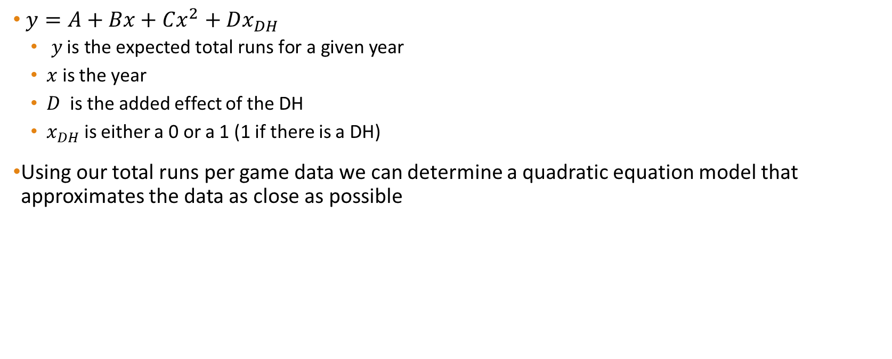
Quadratic Regression
$y=A+Bx+Cx^{2}+Dx_{DH}$
$y \text{is} \text{the} \text{expected} \text{total} \text{runs} \text{for} \text{a} \text{given} \text{year}$
$x$ is the year
$D$ is the added effect of the DH
$x_{DH}$ is either a 0 or a 1 (1 if there is a DH)
Using our total runs per game data we can determine a quadratic equation model that approximates the data as close as possible

Slide 34
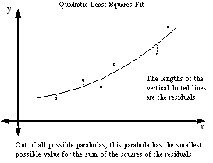
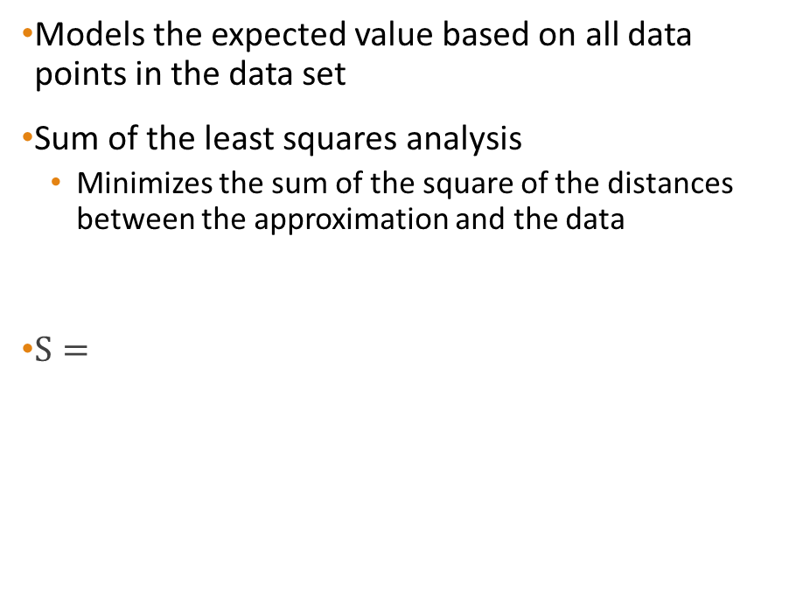
Quadratic Regression
Models the expected value based on all data points in the data set
Sum of the least squares analysis
Minimizes the sum of the square of the distances between the approximation and the data
$S=$
http://www.mathwords.com/l/least_squares_regression_eqn.htm

Slide 35

Quadratic Regression
Get the $a$ coefficient by
$S=$ $=$ $=$
$x=−\frac{b}{2a} ⇒$ $⇒$
(Linear equation with unknown parameters a,b,c)
Preform a similar analysis to get a quadratic function of b and c

Slide 36
Quadratic Regression
Then we have a system of 3 normal equations with 3 unknowns
Use linear algebra to solve this system of equations
n = number of points in the data set

Slide 37
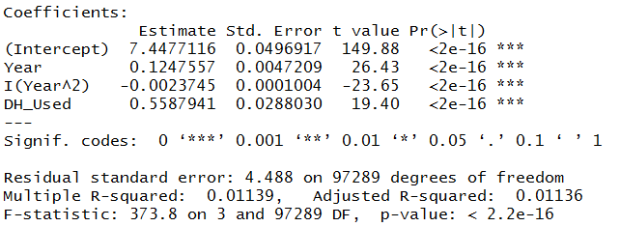
Quadratic Regression
Low p value for the DH being used, which means that there is an effect of having a DH

Slide 38

Quadratic Regression
No DH quadratic regression:$y=A+Bx+Cx^{2}$
DH quadratic regression: $y=A+Bx+Cx^{2}+D$
Coefficients:
$A=$ 7.447712
$B=$ 0.1247557
$C=$ -0.00237452
$D=$ 0.5587941
$n=97294 games$
$i=each game$

Slide 39
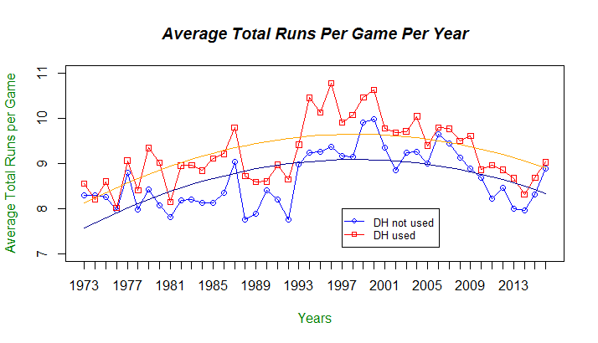
DH vs No DH: Quadratic Regression

Slide 40

DH vs No DH: Score Differential
0.5587941 total runs added per game with DH
0.27939705 runs per team
28760 $≈$ 29% of all games determined by one run
$≈$ 12 games a year per team
A few more wins a season will influence whether a team will make the playoffs

Slide 41
Interleague Theory
Since 1996 there have been interleague games
Since 2013, each MLB team plays 20 interleague games a season
10 home games
10 away games
When NL teams go to play in AL parks they are allowed to use a DH
But since they only play 10 games out of 162 games a year that allow for a DH, it doesn’t make sense to reserve a roster spot throughout the year for a player that will only play in 10 games
Since all the good hitters are already in the batting order, the best hitter among the reserves is the best option for teams to fill the DH position
This gives an obvious advantage to the AL team which offers a specialty hitter vs a backup player

Slide 42
Interleague Theory
When AL teams go to play in NL parks
Pitchers in both leagues are terrible hitters the offensive production of the game isn’t influenced as greatly
Pitchers in the AL don’t have to hit and don’t prepare and practice hitting
Some claim that this is responsible to a number of pitchers injuring themselves
Chien-Ming Wang suffered a foot injury in 2008 that missed the rest of the season
A DH is used in NCAA baseball

Slide 43
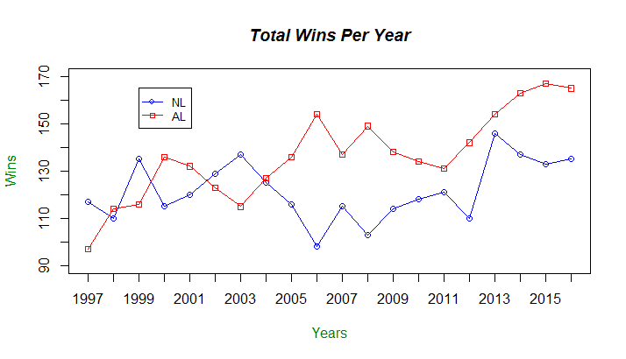
Interleague Play: All Wins

Slide 44
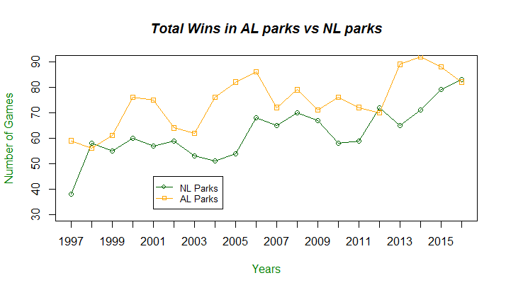
Interleague Play: American League Wins

Slide 45
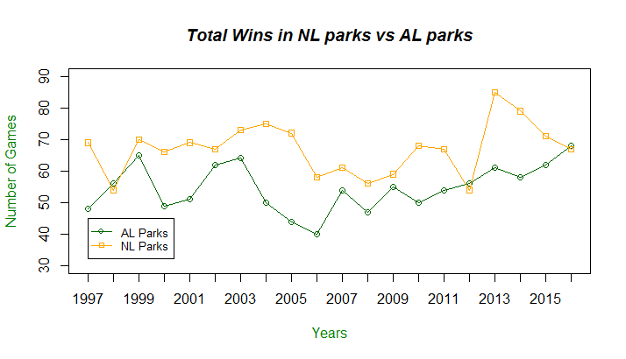
Interleague Play: National League Wins

Slide 46
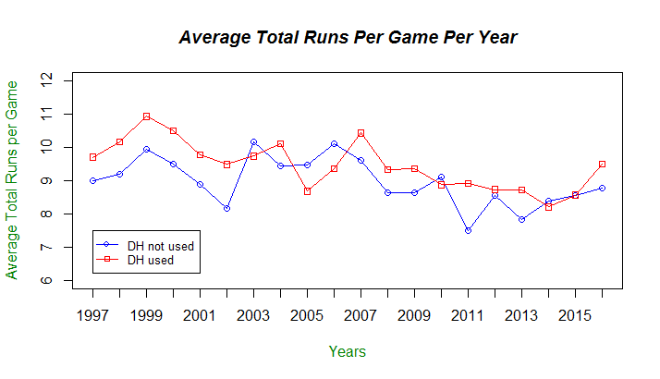
Interleague Play: Average Score

Slide 47
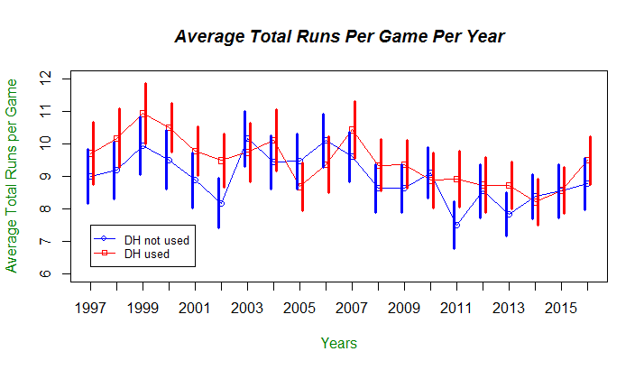
Interleague Play: Confidence Interval

Slide 48
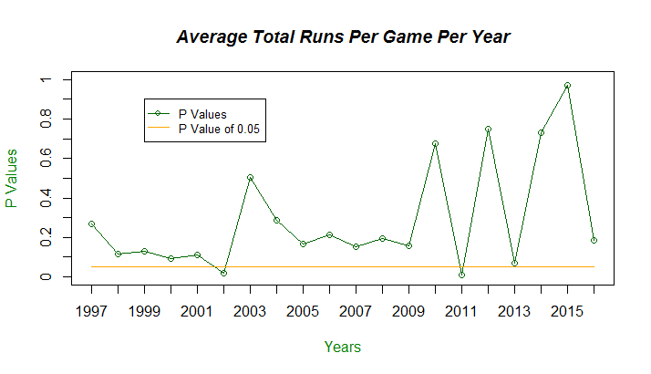
Interleague: P Values

Slide 49
Interleague Play

Slide 50
Conclusion
All games (1973 – 2016):
P values significant in 33 of 44 years
Confidence Intervals overlap in 22 of the 44 years
Some supporting evidence to support that the DH affects the average total runs scored in MLB
Interleague Play (1997 – 2016):
P values only significant in 2 of 20 years
Confidence Intervals always overlap
Not enough evidence to support that the DH influences the wins or average total runs per game
Further exploration
Individual player data including BA, OBP, SLG

Slide 51
References
"Baseball Rule Change Timeline." Baseball Almanac. N.p., 2016. Web. 01 June 2017.
"Download Lahman’s Baseball Database." Sean Lahman | Database Journalist. Sean Lahman, 2016. Web. 01 June 2017.
(Player data)
"List of Major League Baseball Batting Champions." Wikipedia. Wikimedia Foundation, 18 May 2017. Web. 01 June 2017.
"Major League Baseball." Wikipedia. Wikimedia Foundation, 30 May 2017. Web. 01 June 2017.
"Play-by-Play Data Files." Retrosheet Event Files. Retrosheet, 6 Dec. 2016. Web. 01 June 2017.
(Game data)
"Sabermetrics." Wikipedia. Wikimedia Foundation, 31 May 2017. Web. 01 June 2017.
"The Sabermetric Manifesto." Sean Lahman | Database Journalist. Sean Lahman. Web. 01 June 2017.
"Tools, John Galt's. "Probability Of Playing College and Professional Baseball." Probability. N.p., 2016. Web. 01 June 2017.

Slide 52
Thank you

